Slide 1
Malabar Caterers – Catering Order Management System
Academic Project Presentation

Slide 2
Problem Statement
• Manual catering order handling is time-consuming
• Difficulty tracking customer requests
• Need for centralized order management
• Lack of analytics for business decisions

Slide 3
Project Objectives
• Collect catering orders online
• Store responses automatically in Google Sheets
• Track order status efficiently
• Generate dashboards and business insights

Slide 4
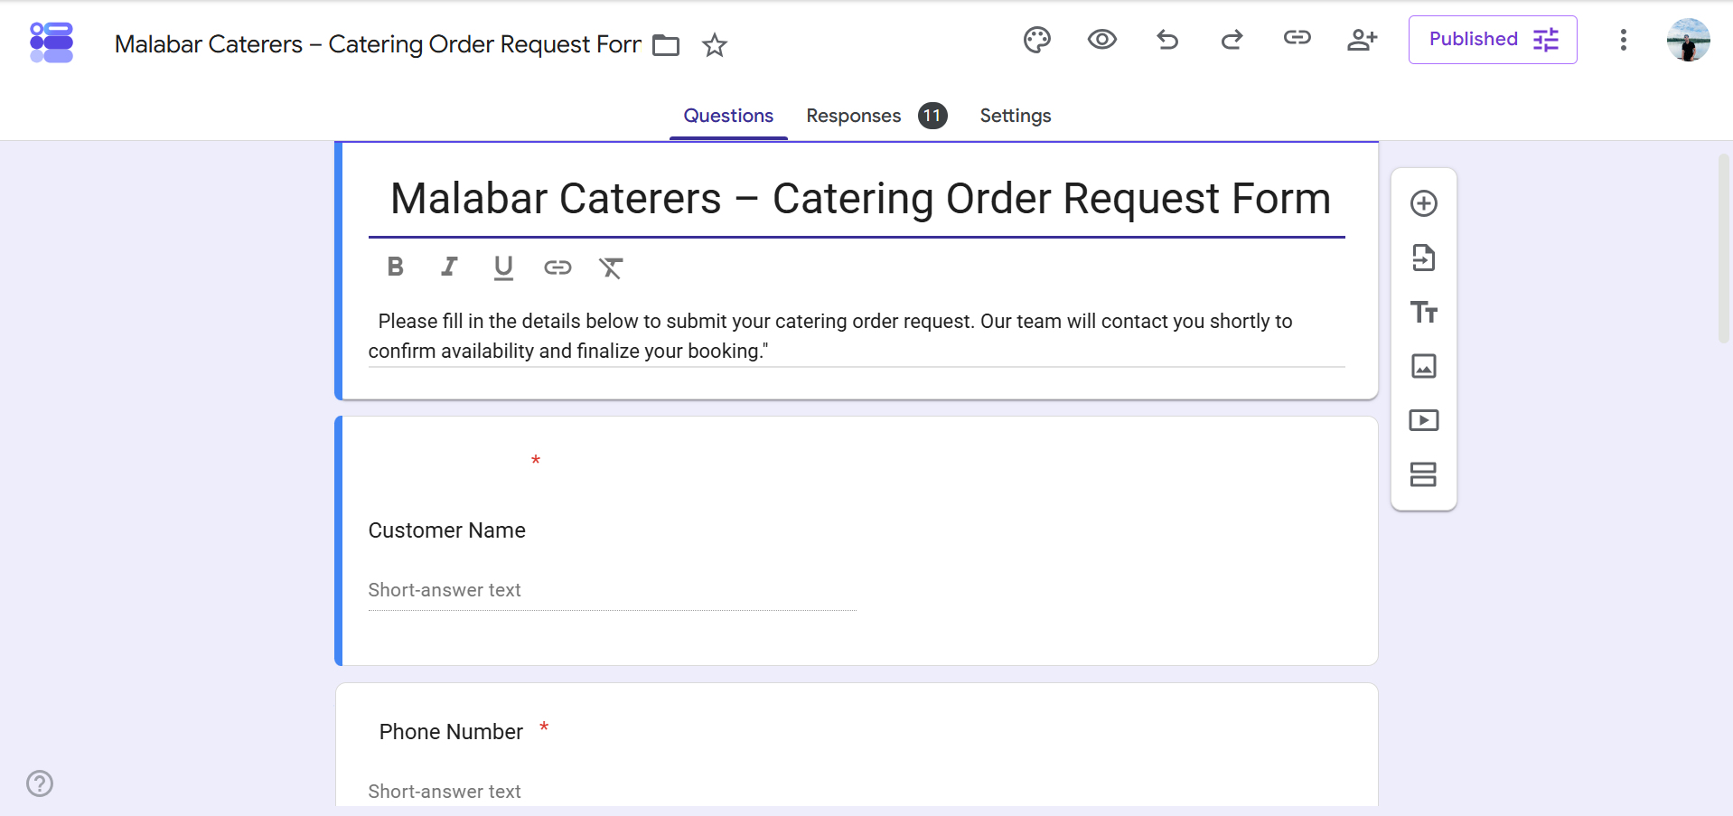
Google Form Interface

Slide 5
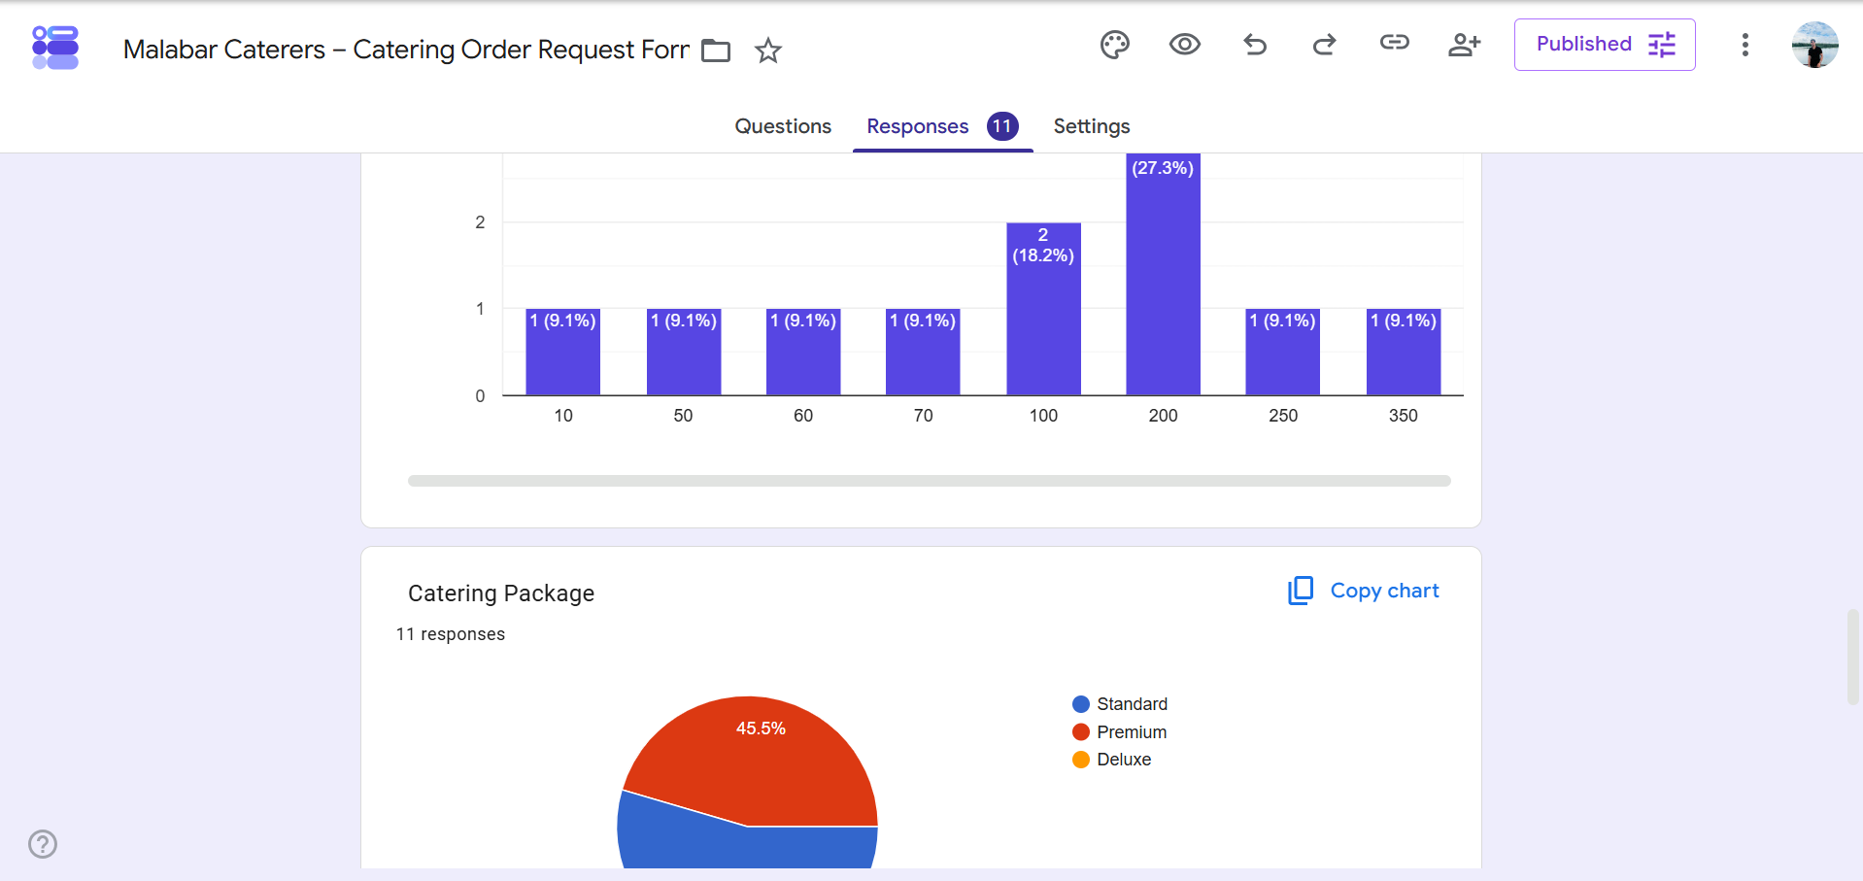
Google Form Responses Analytics

Slide 6
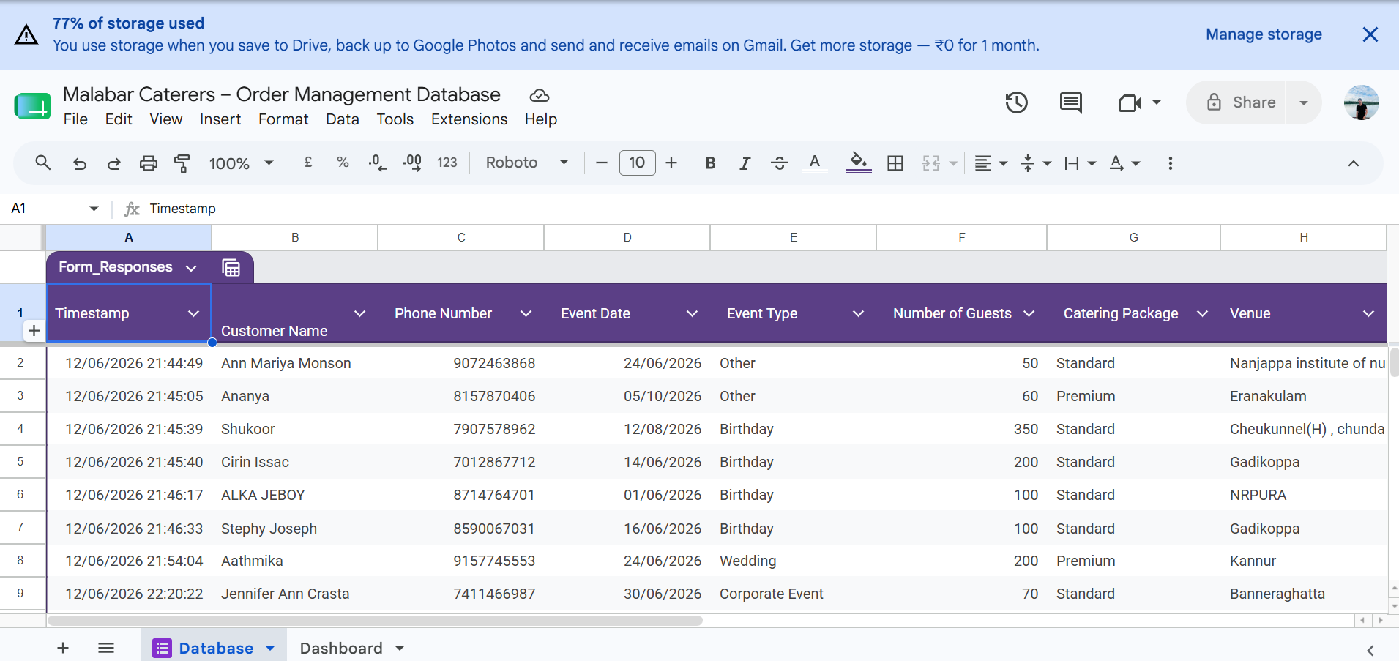
Database Structure

Slide 7
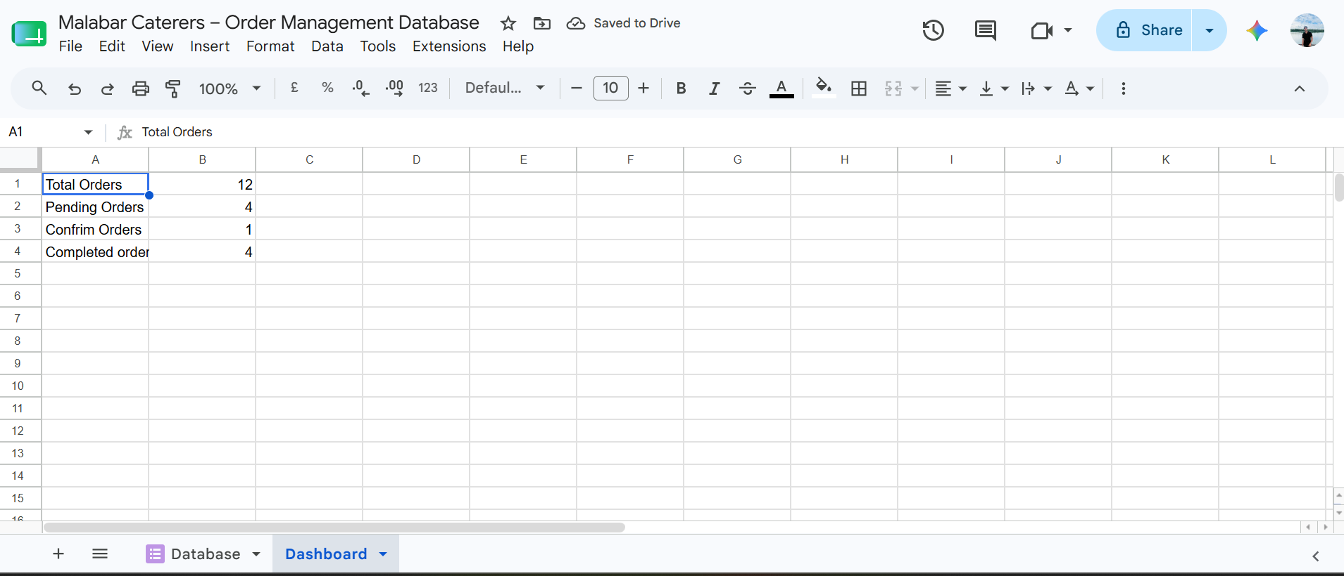
Dashboard Overview

Slide 8
Analytics Performed
• Total Orders Analysis
• Pending, Confirmed and Completed Orders
• Package Popularity Analysis
• Guest Count Distribution
• Event Type Analysis

Slide 9
Predictive Analysis
• Forecast future order volume
• Predict demand for Premium/Standard packages
• Identify peak booking periods
• Estimate guest counts for future events
• Support inventory and staffing planning

Slide 10

QR Code for Google Form Access

Slide 11
Findings & Results
• Online form simplified order collection
• Database automatically stores responses
• Dashboard provides quick business insights
• QR code enables easy customer access

Slide 12
Conclusion & Future Scope
• Successful implementation of catering order system
• Improved efficiency and data management
• Future integration with payment gateways
• Advanced AI-based demand forecasting

